Slide 1
ECNG 4104 ASIC/FPGA HDL Design Flow
Dr. Ahmed Abou-Auf
Fall 2018

Slide 2

This course is about…

Slide 3
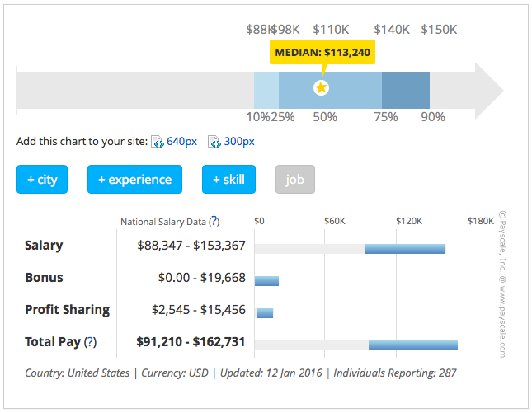
Senior ASIC Design Engineer Salary (US)

Slide 4
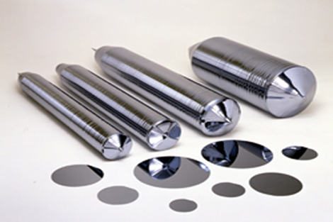
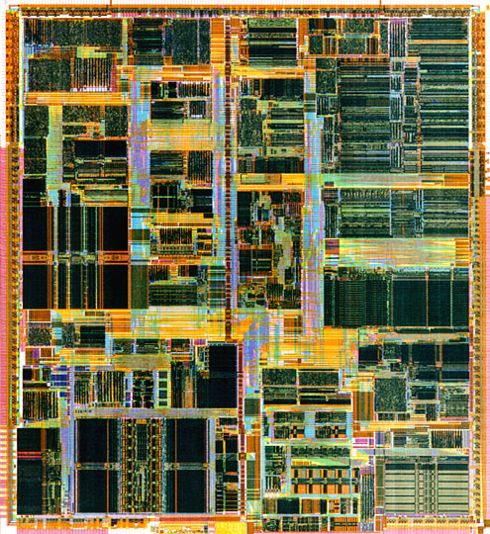
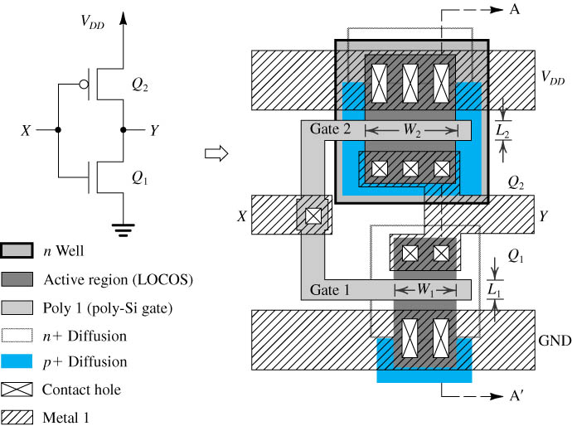
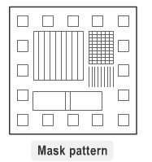
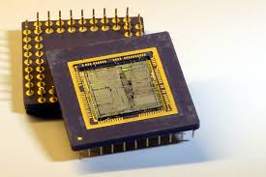
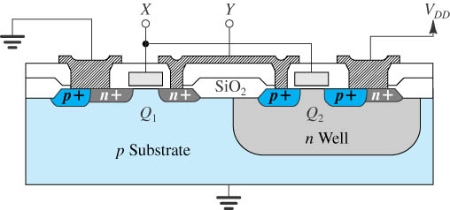
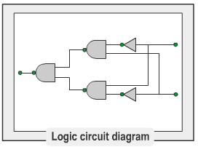
VLSI Fabrication Flow

Slide 5
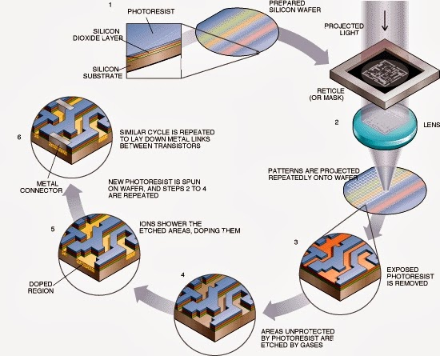
Semiconductor Photolithography

Slide 6

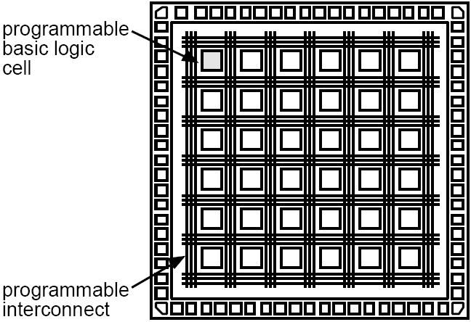
Digital Chip Fabrication Choices—Mask Driven
Digital Circuit Implementation Approaches
Custom
Semicustom
Cell-based
Array-based
Pre-diffused
Pre-wired
(Gate Arrays)
(FPGA's)
FPGA
ASIC

Slide 7
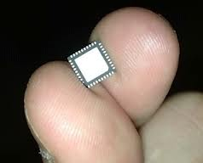
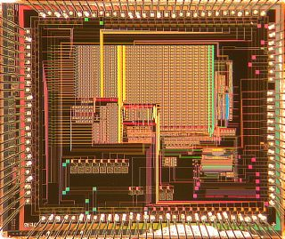
Cell-Based ASIC Design Flow
RTL
VHDL/Verilog
Verify
Function
Synthesis
Clock Tree
DFT/BIST
& ATPG
Cell-Level
Netlist
Verify
Function & Timing
Test vectors
Library of Cells
DRC & LVS
Verification
Physical
Layout
Map/Place/Route
Verify
Timing
Tape out (GDSII file)
Notes:
GDS II is a database file format which is the de facto industry standard for data exchange of integrated circuit or IC layout artwork

Slide 8
ASIC Standard Cell Library: Example

Slide 9
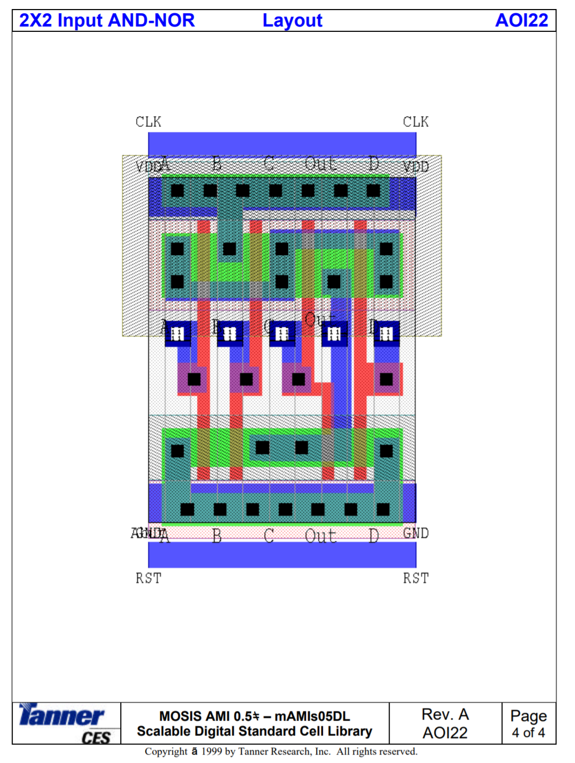
Example of a Cell

Slide 10
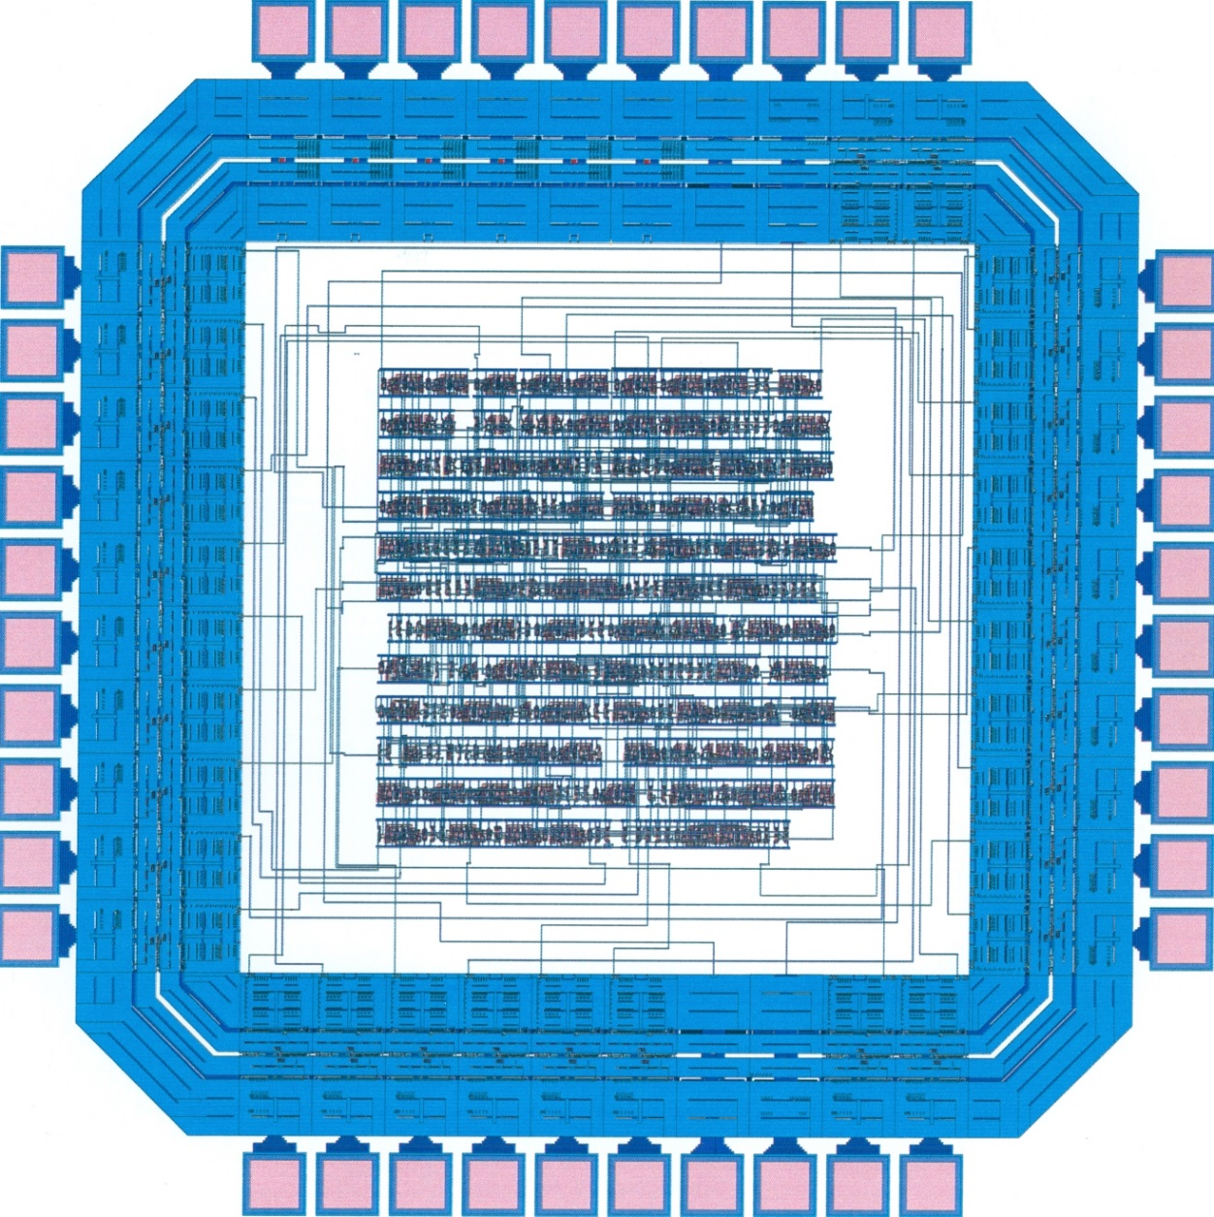
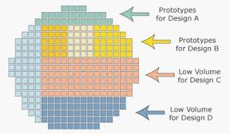

ASIC Prototyping: Multi-Project Wafer

Slide 11
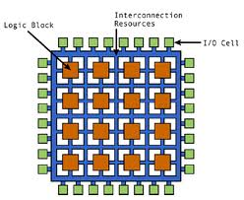
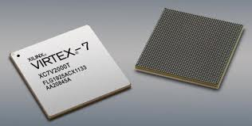
FPGA Design Flow
RTL
VHDL/Verilog
Verify
Function
Synthesis
Gate-Level
Netlist
Verify
Function & Timing
Physical
Layout
Map/Place/Route
Verify
Timing
FPGA Configuration File

Slide 12
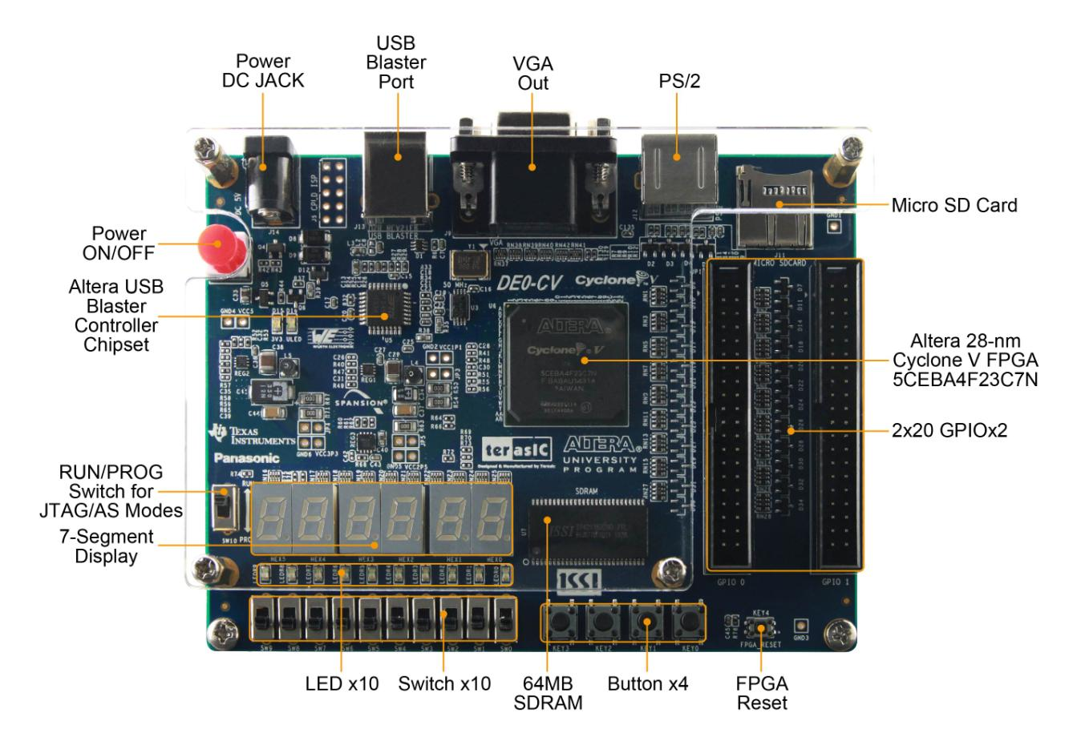
FPGA Development Board: DE0-CV

Slide 13

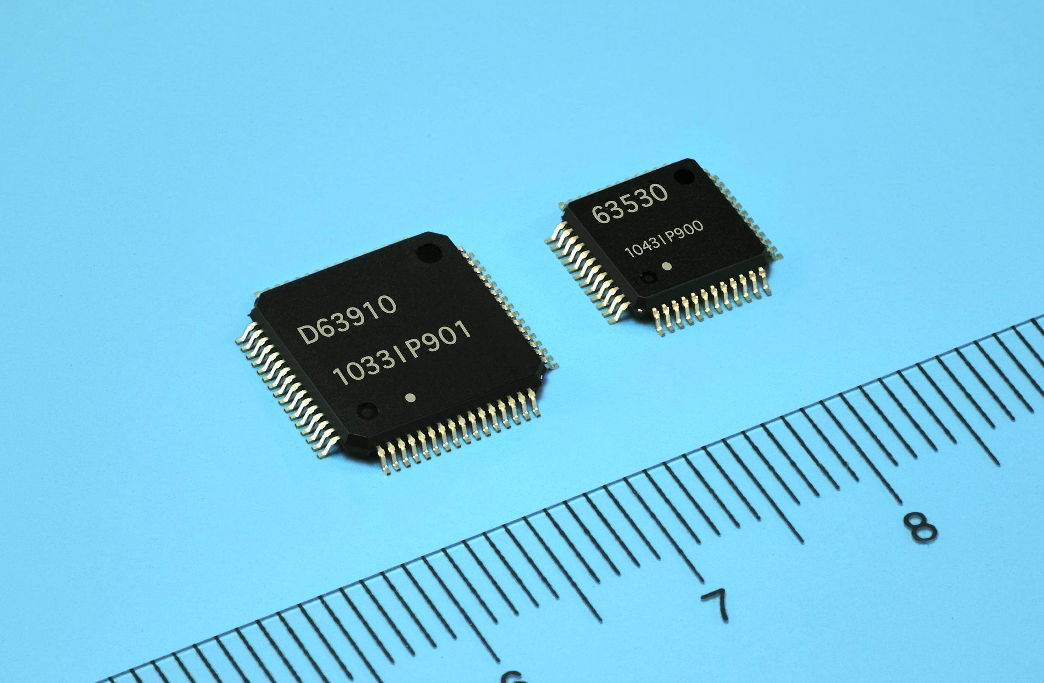
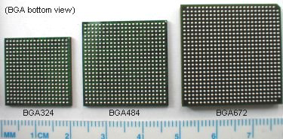
ASIC vs. FPGA
FPGA
bigger area
bigger package
slower
costs $10 - $1000 per part
faster and cheaper
development time
ASIC
less area
less power
faster
costs $1 a part in a volume of 1 million parts
longer and more costy development time

Slide 14
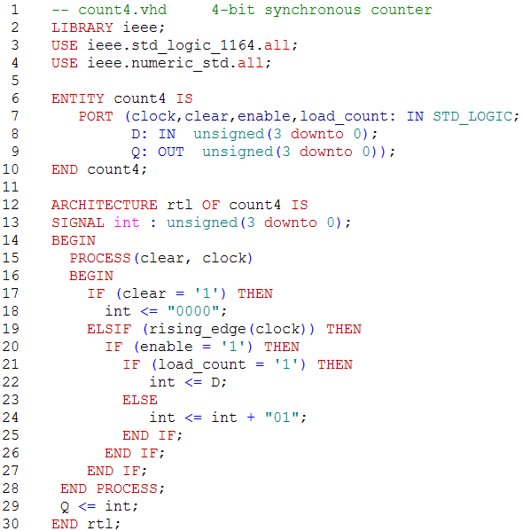
Design Entry—RTL VHDL
D
load_count
Q
clear
clock
enable

Slide 15
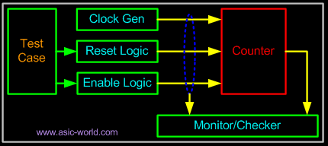
Verification using Testbench
a virtual lab “bench” that includes
Design unit under test (UUT)—circuit board to be tested
Input stimuli—signal generator
Output monitor—logical analyzer

Slide 16
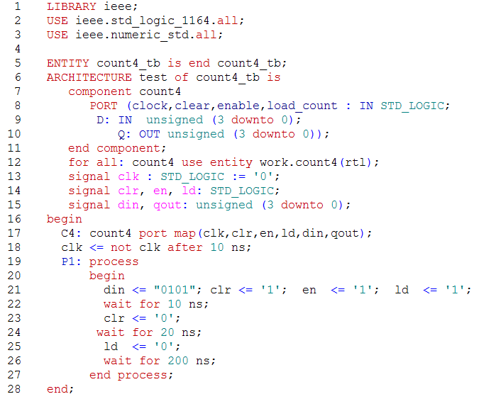
VHDL Testbench—count4_tb
count4_tb
D
count4
load_count
Q
clear
Clk
gen
clock
enable

Slide 17
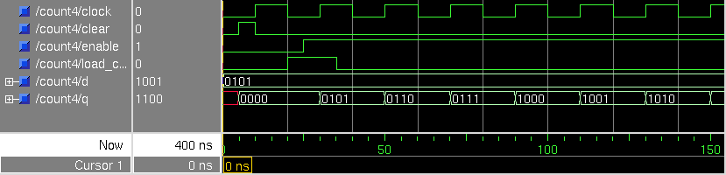
Count4 – Simulation waveform
Clear
Counting
Parallel
Load

